Slide 1

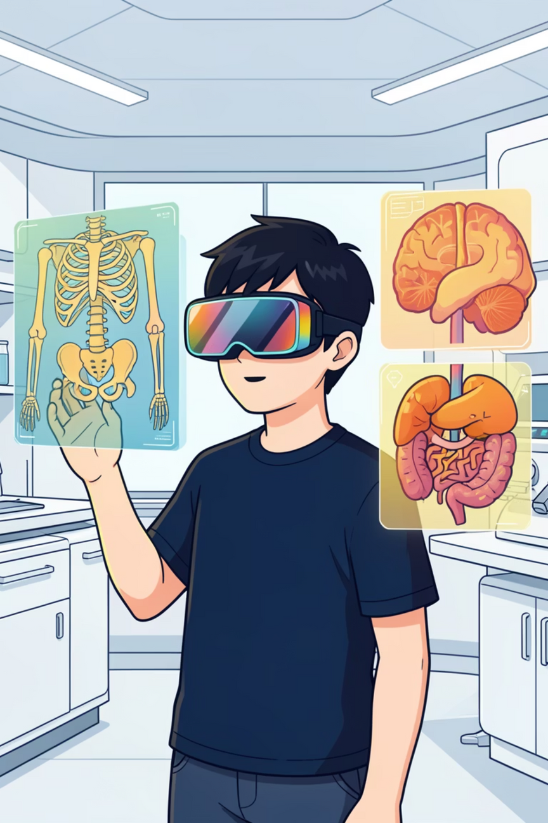

Revolutionising Anatomy Education with AR/VR
Group Name : Out Of Scope
Group Members: Tanisha (102315108)
Irina Garg (102315221)
Vivan Khatri (102315225)
Notes:
1

Slide 2
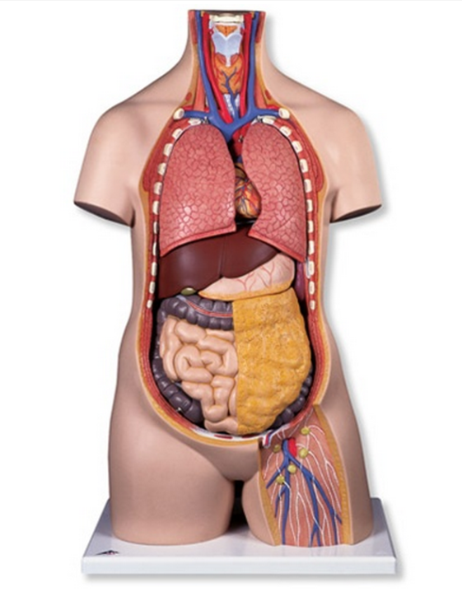
Problem Statement
Anatomy learning relies on static 2D diagrams and textbooks
Students find it difficult to visualize 3D organ structures
Complex spatial relationships are hard to understand and remember
Limited access to cadavers and physical models
Existing digital tools offer passive learning with low interaction
This results in low engagement and poor conceptual clarity
There is a need for a cost-effective, interactive solution
AR/VR-based anatomy learning enables 3D visualization, interaction, and better understanding
Notes:
1

Slide 3

The Challenge of Traditional Anatomy Learning
Limited Engagement
Conceptual Difficulty
Passive Learning
Static 2D diagrams often fail to capture student attention and enthusiasm.
Understanding intricate 3D relationships from flat images can be a significant hurdle for beginners.
Traditional methods typically involve passive absorption of information rather than active exploration.
Notes:
2

Slide 4
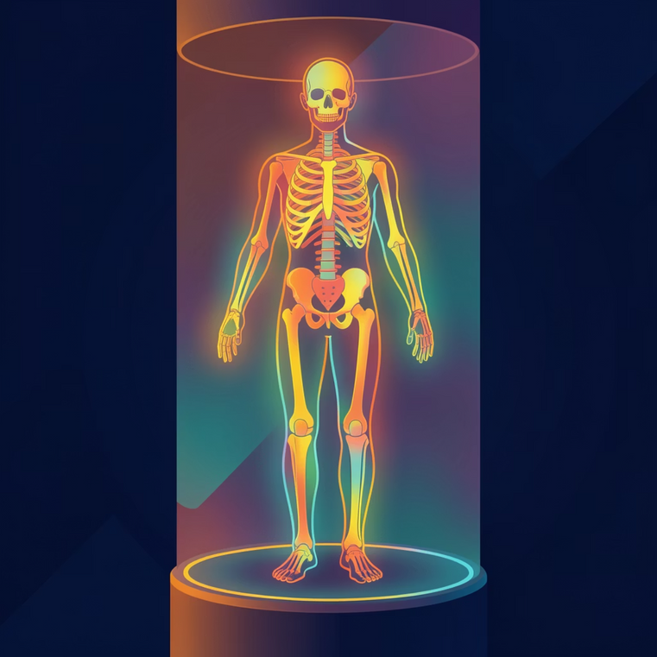

Introducing Interactive 3D Visualisation
Our project develops a beginner-friendly AR/VR-based anatomy learning application. It leverages the power of interactive 3D visualisation to simplify the understanding of human anatomy.
Students can immerse themselves in a dynamic learning environment, moving beyond the limitations of traditional textbooks.
Notes:
3

Slide 5

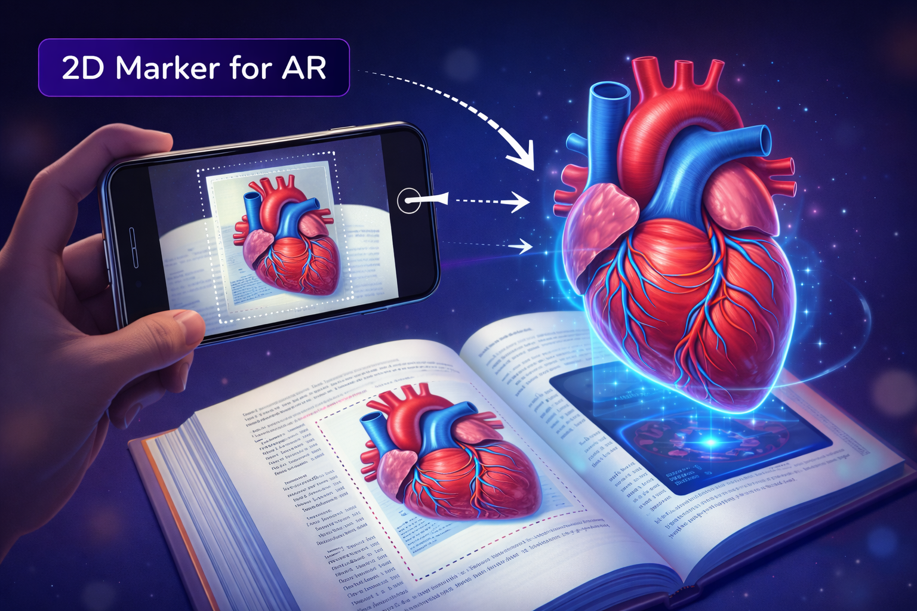


How It Works: Seamless AR Integration
2D Image as Marker
A 2D image from a textbook acts as a reference marker for the system.
Camera Detection
When the device's camera detects this image, it triggers the AR experience.
3D Model Overlay
A pre-designed 3D anatomical model is then displayed directly on the image, creating an immersive overlay.
Notes:
4

Slide 6
Dynamic Interaction for Deeper Understanding
The application empowers users with advanced interactive capabilities, far beyond what static images can offer.
Rotate Models
Explore Layer-by-Layer
Examine structures from every angle, gaining a comprehensive spatial understanding.
Dissect and rebuild organs virtually, understanding their complex internal architecture.
Zoom & Pan
Focus on intricate details or view the broader context of anatomical systems.
Notes:
5

Slide 7


Technological Foundation
Our application is built on robust and widely adopted development platforms, ensuring stability and rich functionality.
Unity for 3D Rendering
Unity provides the powerful engine for creating and rendering high-fidelity 3D anatomical models and interactive environments.
Vuforia for Image Recognition
Vuforia's advanced computer vision capabilities enable accurate and rapid detection of 2D textbook images as AR markers.
Notes:
6

Slide 8
Key Benefits of Our Approach
Enhanced Conceptual Clarity
Increased Engagement
Visualising 3D structures directly leads to a much clearer understanding than 2D diagrams.
Interactive and immersive experiences captivate students and foster a deeper interest in anatomy.
Self-Paced Learning
More Effective Education
Students can explore at their own pace, revisiting complex areas as needed without external pressure.
The combination of these benefits results in a significantly more impactful and memorable learning process.
Notes:
7

Slide 9
Project Scope: Initial Focus
For our initial 2-3 week project timeframe, we are concentrating on a targeted set of anatomical structures to ensure a high-quality, beginner-friendly experience.
5-10 Vital Organs
1
We will include a selection of 5 to 10 fundamental 3D organs critical for foundational anatomy learning.
Low Scope, High Impact
By keeping the scope focused, we ensure a polished and effective initial application within the tight development schedule.
2
Notes:
8

Slide 10
Resource / Budget
Material Resources
AR-compatible smartphone for testing and demonstration
Laptop / PC (minimum 8 GB RAM) for Unity development
Unity (Student Version) for AR application development
Vuforia SDK for 2D image (marker) recognition
Free/open-source 3D anatomical models
Textbook images used as AR markers
Budget
No paid software or hardware required
All tools are free for academic use
Devices are already available with team/university
No external funding required
Notes:
8

Slide 11
Thank You
Notes:
8

